Slide 1
NEW discovery on Titanic problem by simplifying previously obtained SVM model
Lee Cheuk YIn

Slide 2
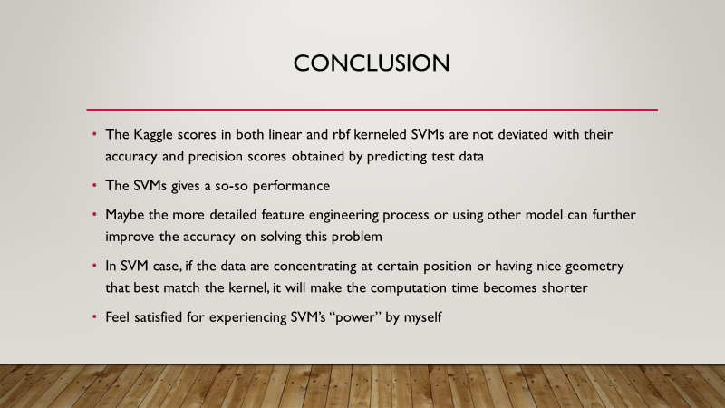
Let’s Review…
Linear SVM Accuracy | 0.7715355805243446
Linear SVM Precision | 0.7474747474747475
Linear SVM Recall | 0.6727272727272727
RBF SVM Accuracy | 0.7940074906367042
RBF SVM Precision | 0.7835051546391752
RBF SVM Recall | 0.6909090909090909
Kaggle Score of Linear SVM | 0.77272
Kaggle Score of RBF SVM | 0.77511

Slide 3
Previously known fact
Centralization of data facilitates SVM operation
Datapoints having matched shape with correctly chosen kernel optimize SVM performance

Slide 4
NEW hypothesis
Reducing number of feature, may result in better performance of SVM in classification
Verify that by carrying more data cleansing

Slide 5
Data preprocessing

Slide 6
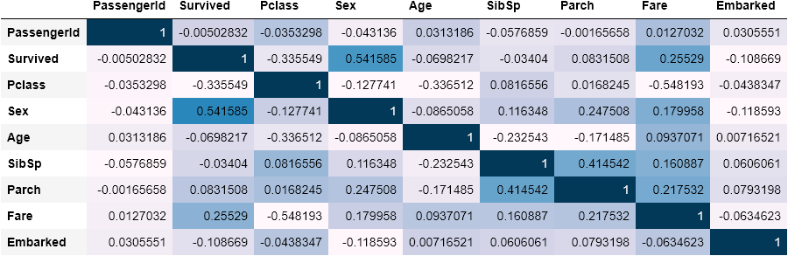
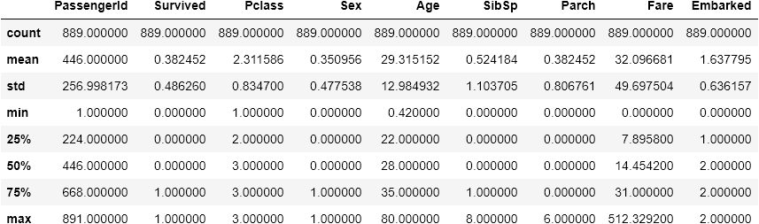
Data Summary
Obtain Same data summary

Slide 7
Key part: Data cleansing
“Name”, “Ticket” and “PassengerId” : remove because having no relationship with survival of passengers
“Cabin”: there are so many missing values and haven’t shown obvious correlation with passengers survival
* “Embarked”: after digitize the variable, the values of number will generate uneccessary weighting to the model, in fact it doesn’t have numeric meaning, so need to remove
** feature “SibSp” and “Parch” are clearly skewed towards right-hand side (i.e. not centralized)

Slide 8
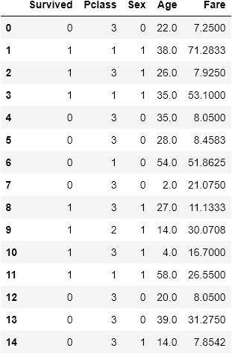
Data After cleansing (partial)

Slide 9
Model performance (Comparison)

Slide 10
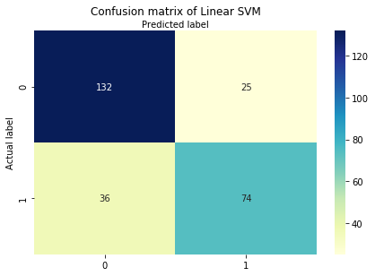
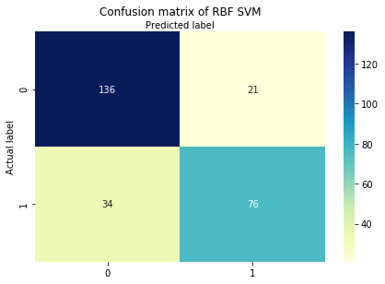
confusion matrix (Linear SVM)
Previously obtained
After further data cleansing

Slide 11
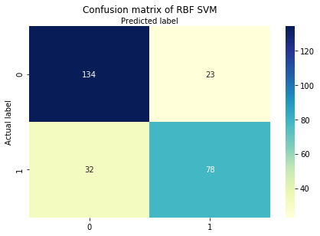
Confusion matrix (RBF SVM)
Previously obtained
After further data cleansing

Slide 12
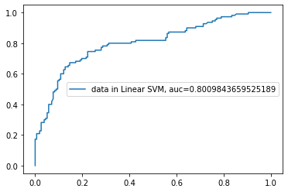
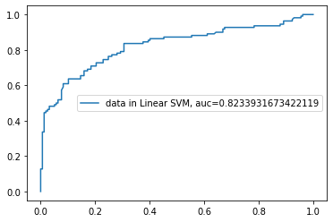
Roc curve (VALIdation)
Previously obtained
After further data cleansing

Slide 13
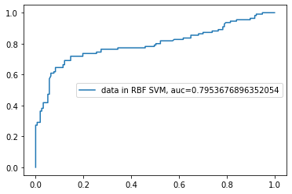
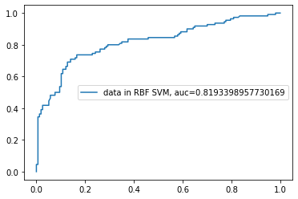
Roc curve (VALIdation)
After further data cleansing
Previously obtained

Slide 14
Score
 | Before removing “Parch” and “SibSp” | After removing “Parch” and “SibSp”
Linear SVM Accuracy | 0.7715355805243446 | 0.7677902621722846
Linear SVM Precision | 0.7474747474747475 | 0.7448979591836735
Linear SVM Recall | 0.6727272727272727 | 0.6636363636363637
RBF SVM Accuracy | 0.7940074906367042 | 0.7940074906367042
RBF SVM Precision | 0.7835051546391752 | 0.7722772277227723
RBF SVM Recall | 0.6909090909090909 | 0.7090909090909091
Kaggle Score of Linear SVM | 0.77272 | 0.76555
Kaggle Score of RBF SVM | 0.77511 | 0.77751

Slide 15
Conclusion
No significance difference on the performance of model after deleting features “SibSp” and “Parch”
Proven this SVM model can be further simplified without sacrifice of performance
Previous obtained SVM model is overfitted
Simplifying model favor faster training time and reduce complexity of model
Useful technique in machine learning

Slide 16
The End

